Slide 1
Four Quadrants of Planning By G.Thota

Slide 2
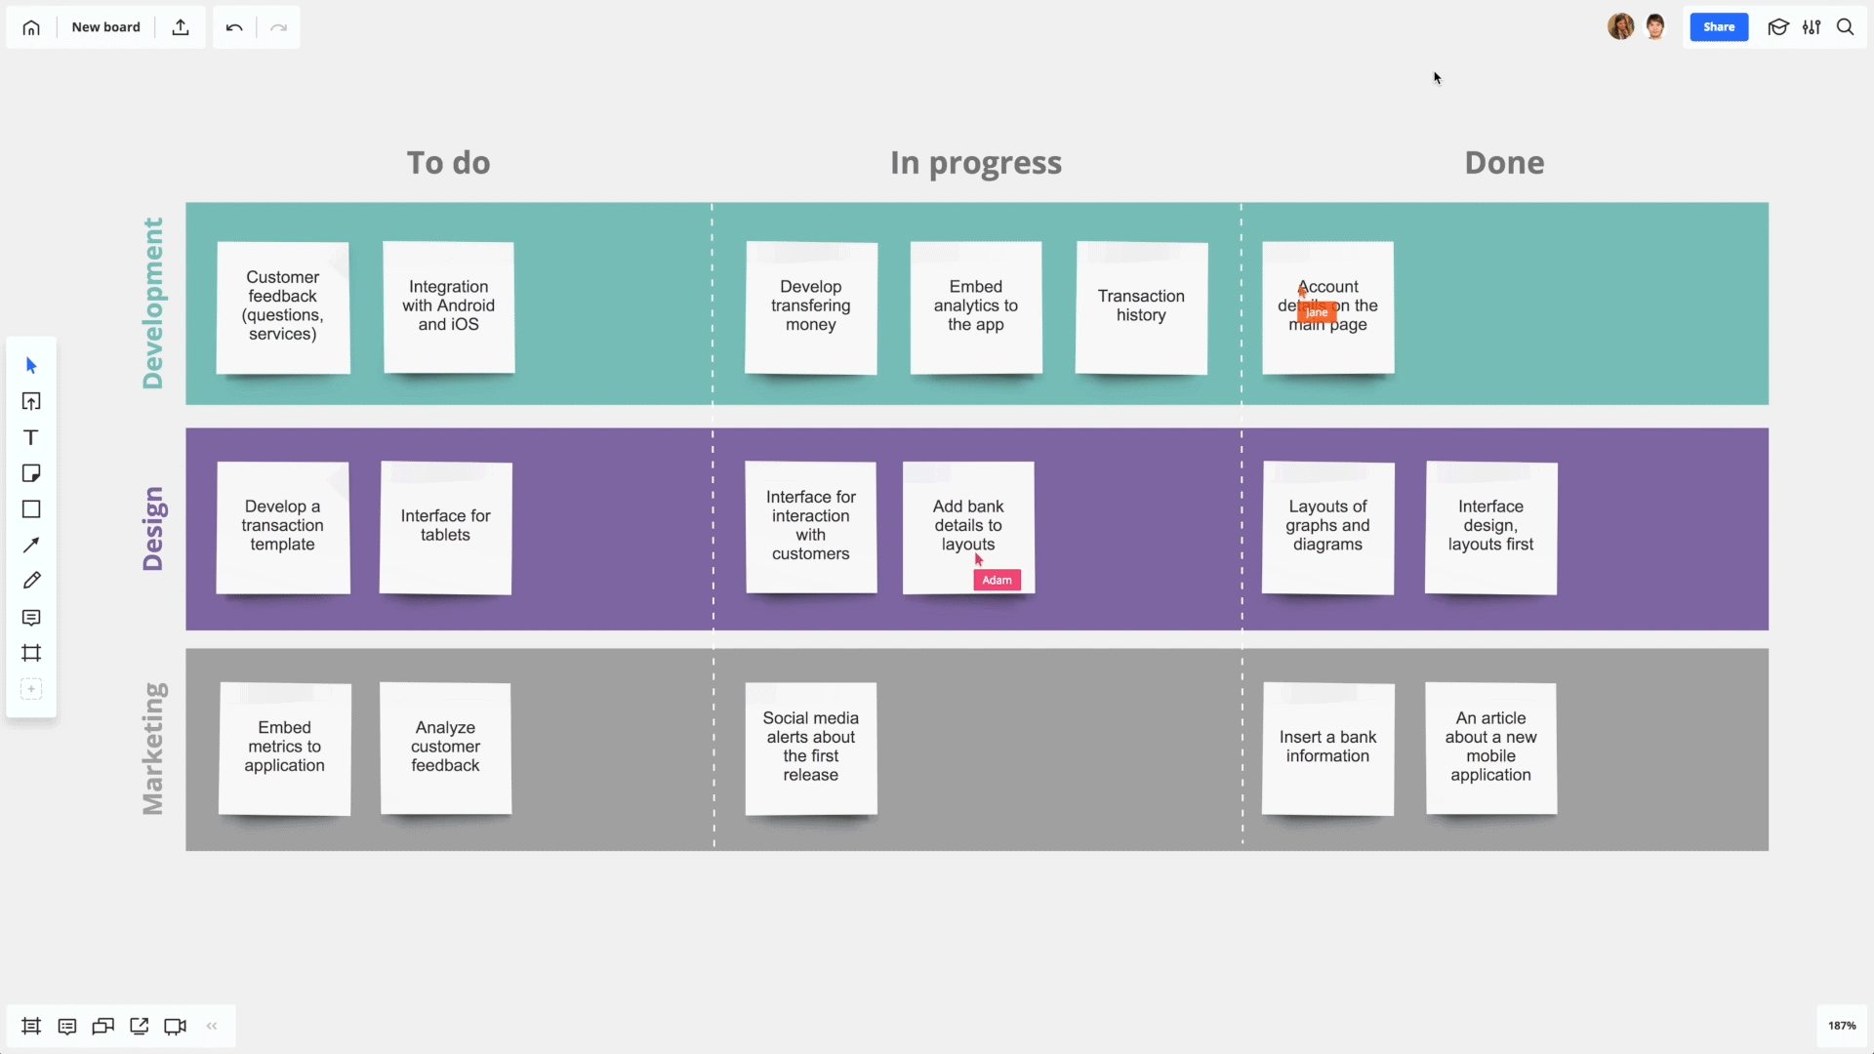
Notes:
No I am not going to tell you how to do the planning to create a better application or software, as I believe you all are really very good and experienced at it. But I am going to discuss with you to see how we can plan our day to day work so that we all can be happy and successful in our life which in return will always impact our professional life.

Slide 3
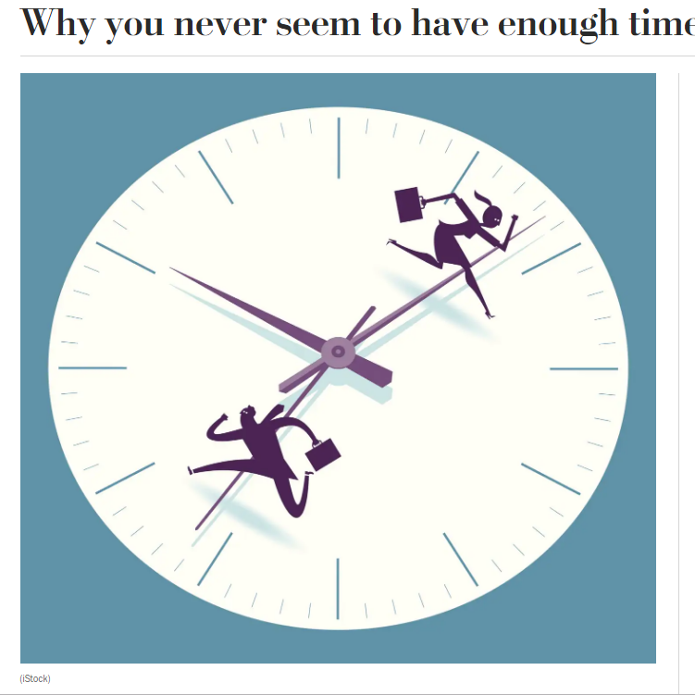
Notes:
I have heard this question from many people, I never seems to have enough time, Why do we never seems to have enough time,

Slide 4

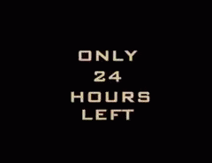
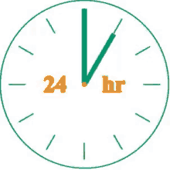
Not Really
Notes:
Fist reason is we all got 24hrs and the second reason is we all got only 24 hrs and in that 8-9hrs of active time we spend on commuting & working, 7-8 hrs sleeping, 2-3 hrs for regular activities and we all are left with just 4-5hrs do you all agree with it? As Toby and Craig are in the hall let me take them as an example with their permission, how many hours do you think Toby and Craig got? 24hrs,
Lets get back to our topic Planning.

Slide 5
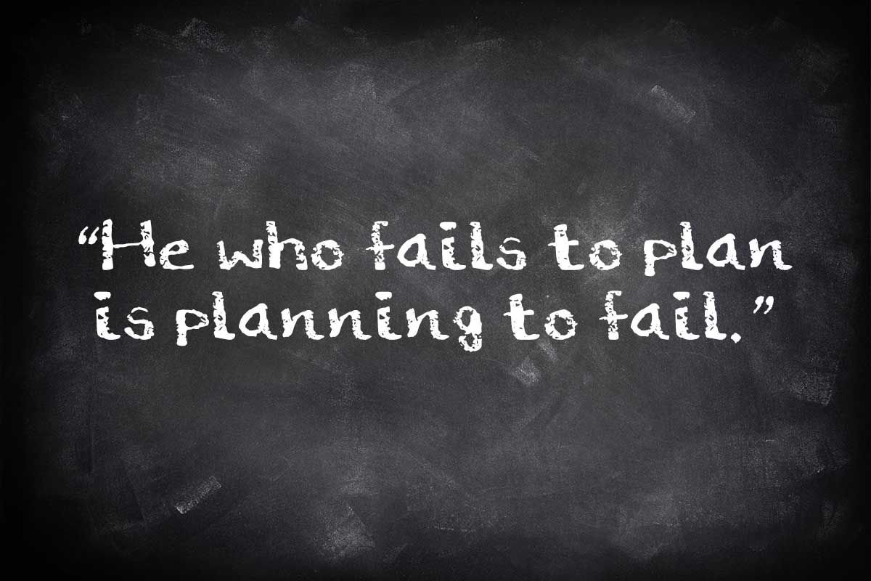
Notes:
so we all very well know the importance of planning, as a software professionals we do a lot of planning but the question is how much planning we do in our personal life, the answer is we do a very little or no planning,
So I thought of sharing with you one of the effective methods of planning our tasks and day to day work,
and I can assure you this method will not only save the money but also time, Some people may be wondering why I said jut not the money but importantly Time,
how many people believe money is important and how many people agree that time is more important.
So what is this Planning using four quadrants or four quadrants of planning

Slide 6
How Many people have seen this before?
Important & Urgent
Important But Not Urgent
Not Important But Urgent
Not Important & Not Urgent
Notes:
But I am going to show you

Slide 7

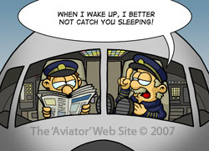


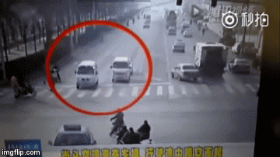
Important & Urgent
Notes:
Catching a bus or a Train for daily commuting purpose
Catching a pre booked flights for holiday
Food and water, Health and hygiene (deodorant in the lift)
Lost credit card or purse or phone reporting them
Car accidents or any incidents which has got to be dealt with it on that spot
Most of the time we don’t have much control over this quadrant as this has to be done.

Slide 8


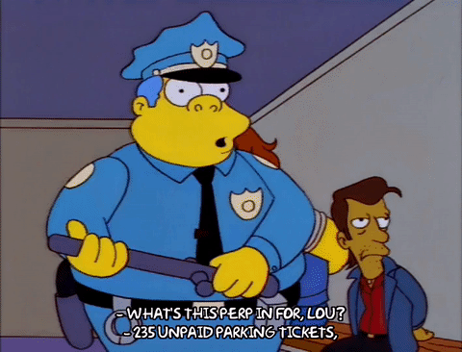
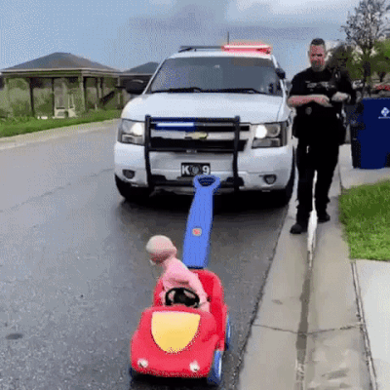
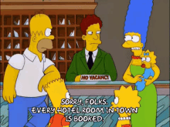
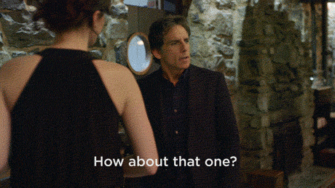
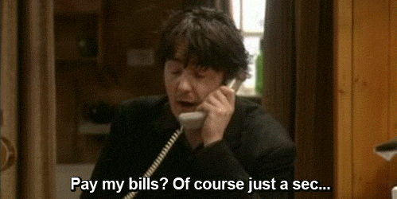
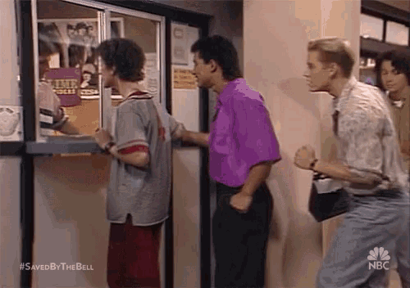
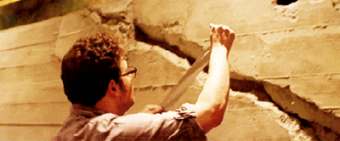
Important & But Not Urgent

Slide 9


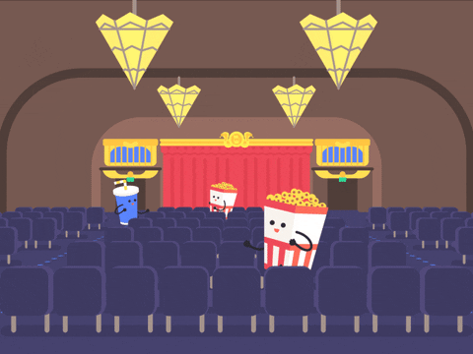

Not Important But Urgent
Events
Pre Booked Shows

Slide 10
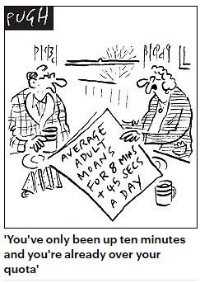


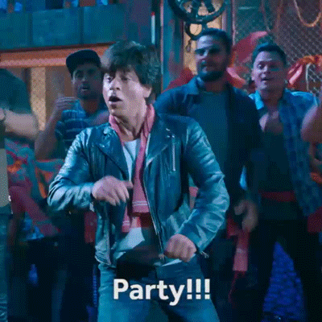
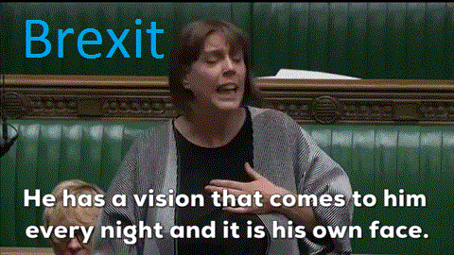
Not Important & Not Urgent
Notes:
Story: Sad, annoyed and Angry about the situation or we always have some problems,

Slide 11
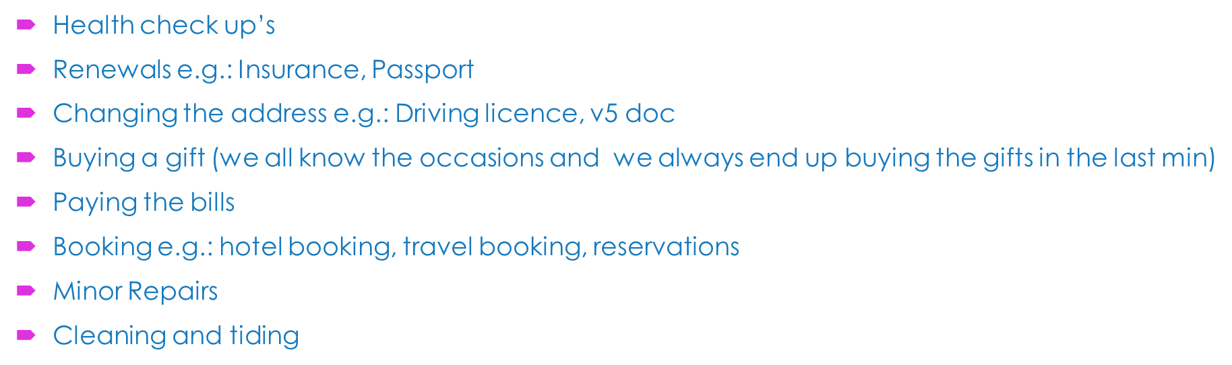
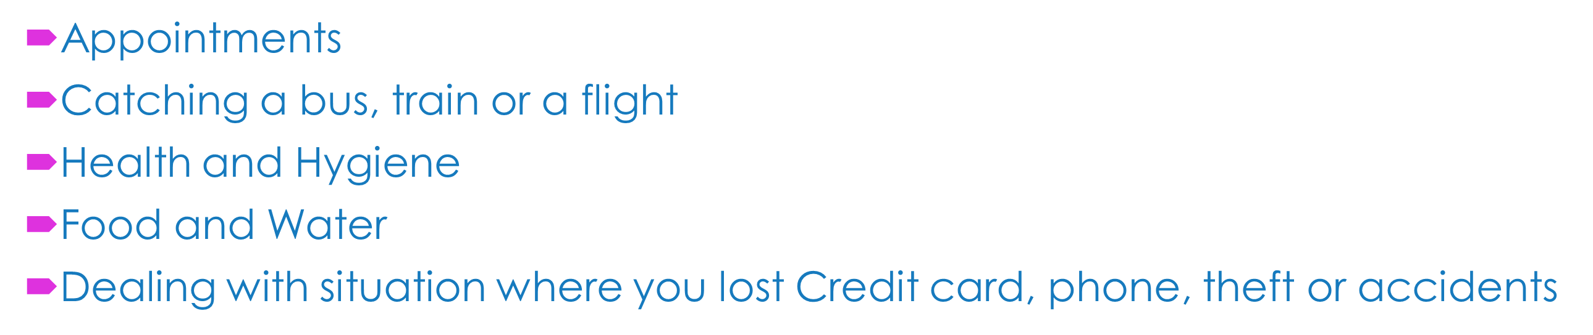
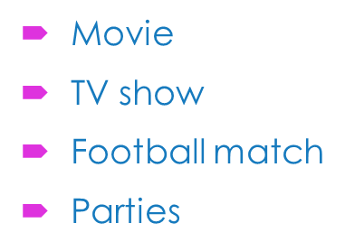
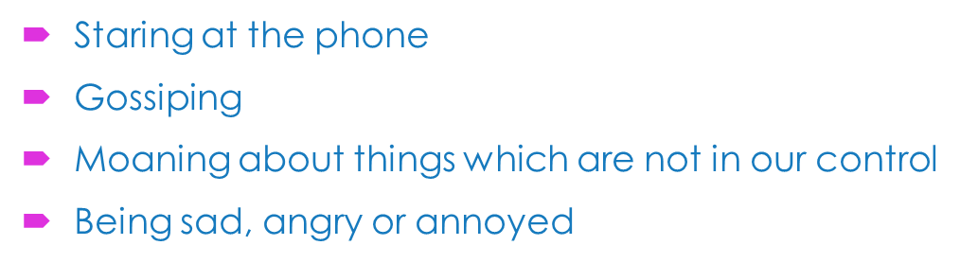
Important & Urgent
Important But Not Urgent
Not Important But Urgent
Not Important & Not Urgent

Slide 12
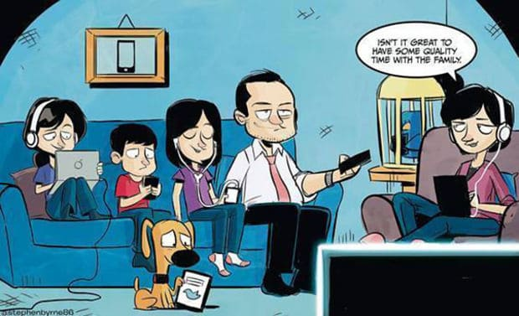
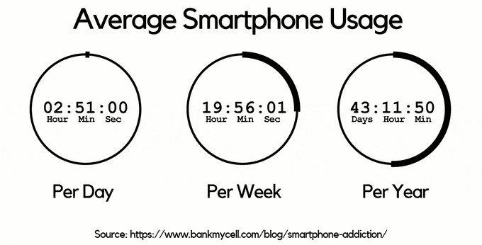
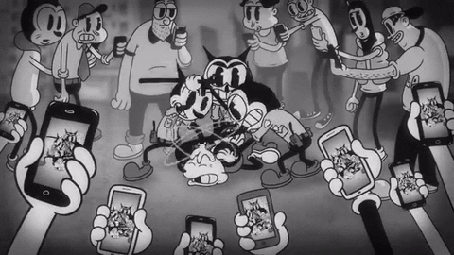


Slide 13
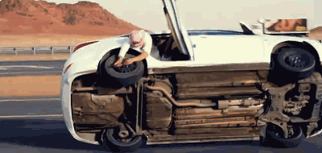
When the Not Urgent becomes Urgent this is how our life will be
Notes:
1. We all know by rushing things we should compromise with the quality, and some times it will be risky. So what is the solution, very simple

Slide 14
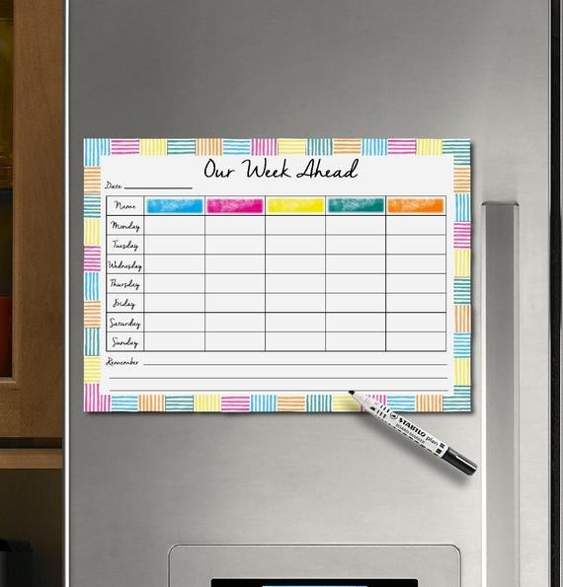
Some Apps which helps us for Planning our work
Cozi Family Organizer (Android, iOS: Free)
Fammle - Family Organizer (iOS: Free)
TimeTree (Android, iOS: Free)
CloudCal (Android: Free)
24me (iOS: Free)
Notes:
Some of you may have seen this kind of apps and boards and some of you are following and Some people may think or expect some thing very different solution from me. But to be honest

Slide 15

Notes:
1: I would like to share a story with you guys how little things make a big difference in the life. One day in a big Action Hall, there are multiple auctions going on and one man came with a violin and

Slide 16
What has changed? And
Notes:
What did changed between not able to sell it for £70 to sold it for £250 - £300, Just a bit of polishing, fine tuning and good presentation. We all are like the violin in the story, but like it happened in the story we can’t expect some one to come change our value or lifestyle by fine tuning us, and even some one tries we may not let them, so It’s our life we have to take an initiative and by making small changes in our daily life we can definitely make a big difference. With adds a huge value as an individual.

Slide 17
Thank You
Gowri Thota
Notes:
We are in the new year, and what we normally do new year resolutions, I believe you all will take this as one of your resolution and I wish you all a wonderful and successful year Ahead, thank you all.

